Slide 1
Customer Relationship Management (CRM) Analysis
Bhagavan Devadi
bhagavan14devadi@gmail.com

Slide 2
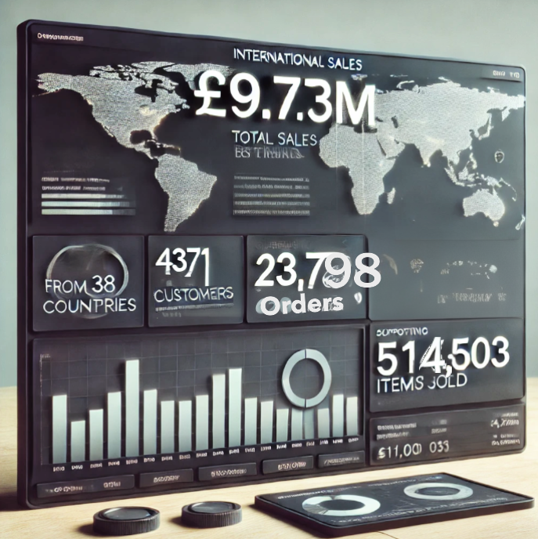
Use Case Overview
Purpose: Segmentation of customers, derive insights to enhance customer retention.
Overview of the dataset: Dataset span from December 2010 to December 2011.
Key metrics: 4371 customers, 23,798 orders, £9.73M in sales across 38 countries.

Slide 3
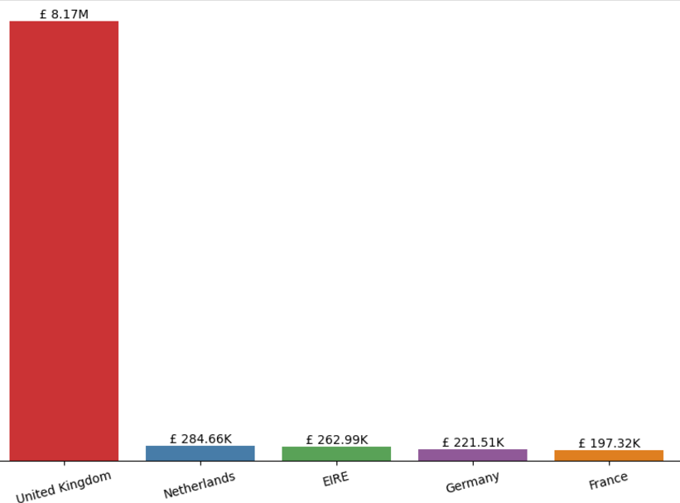
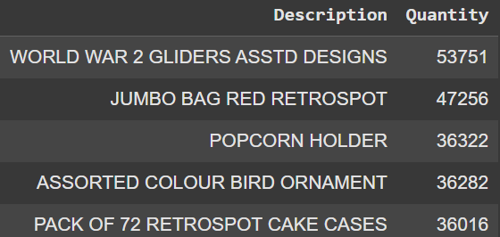
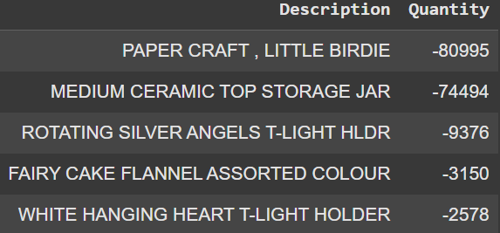
Country Analysis
UK leads with 90% of customers, contributing 84% of sales (£8.17M).
The Netherlands is the second-highest contributor (£284.6K).
Product Analysis
Best-selling: WORLD WAR 2 GLIDERS, JUMBO BAG RED RETROSPOT.
Most canceled: PAPER CRAFT, LITTLE BIRDIE (~80K units).

Slide 4
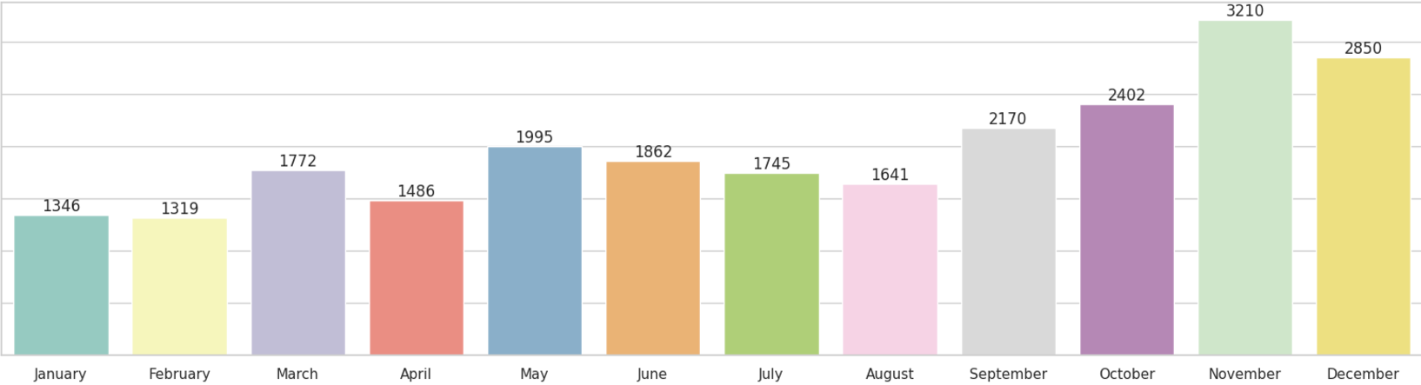
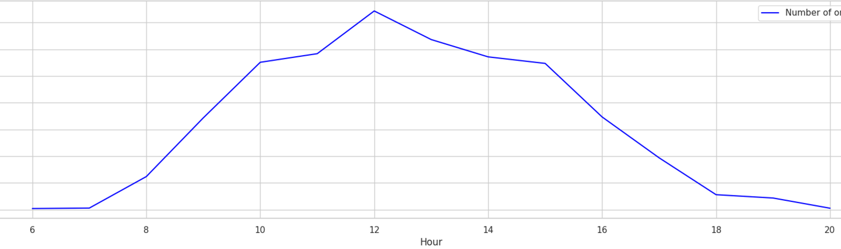
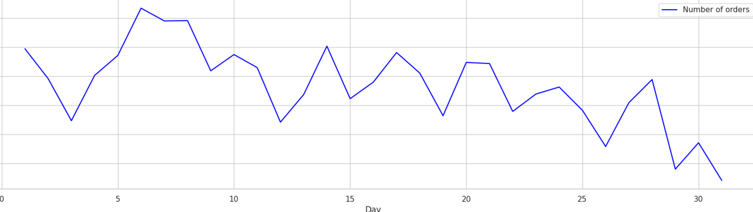
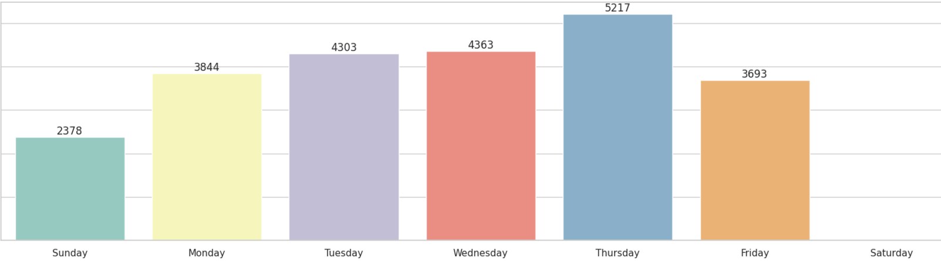
Purchase Trends Overview
01
Highest sales in holiday season, steady rise from September and peaks in November, followed by December
02
Peak sales hours are 9 AM to 4 PM, highest at 12 noon.
03
Sales are strongest in the first 8 days of the month.
04
Thursday is the busiest sales day, no sales on Saturday.

Slide 5
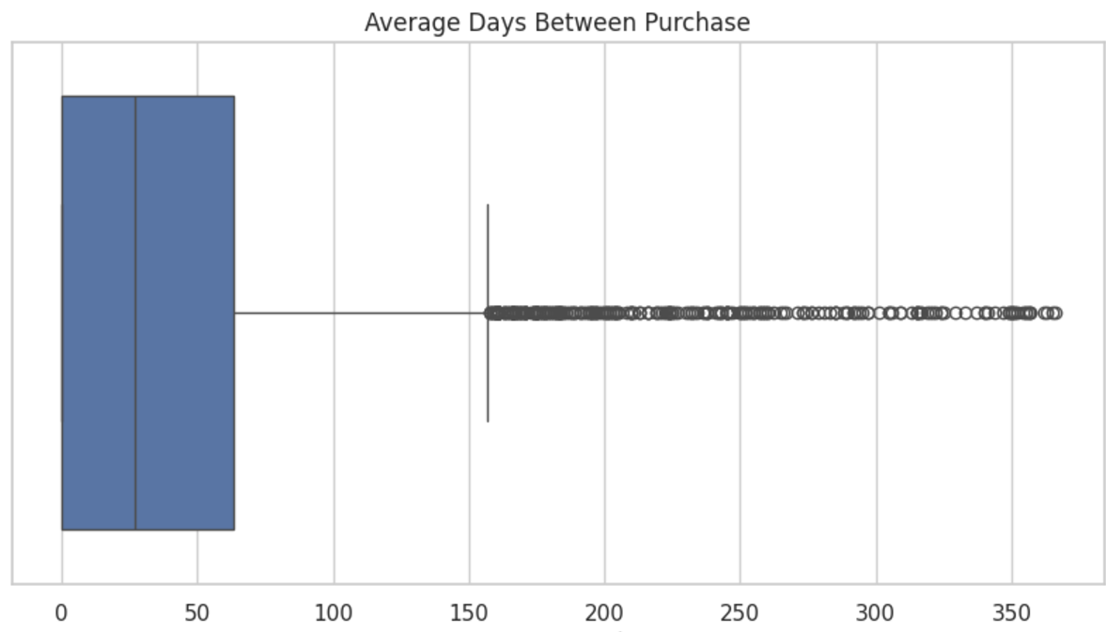
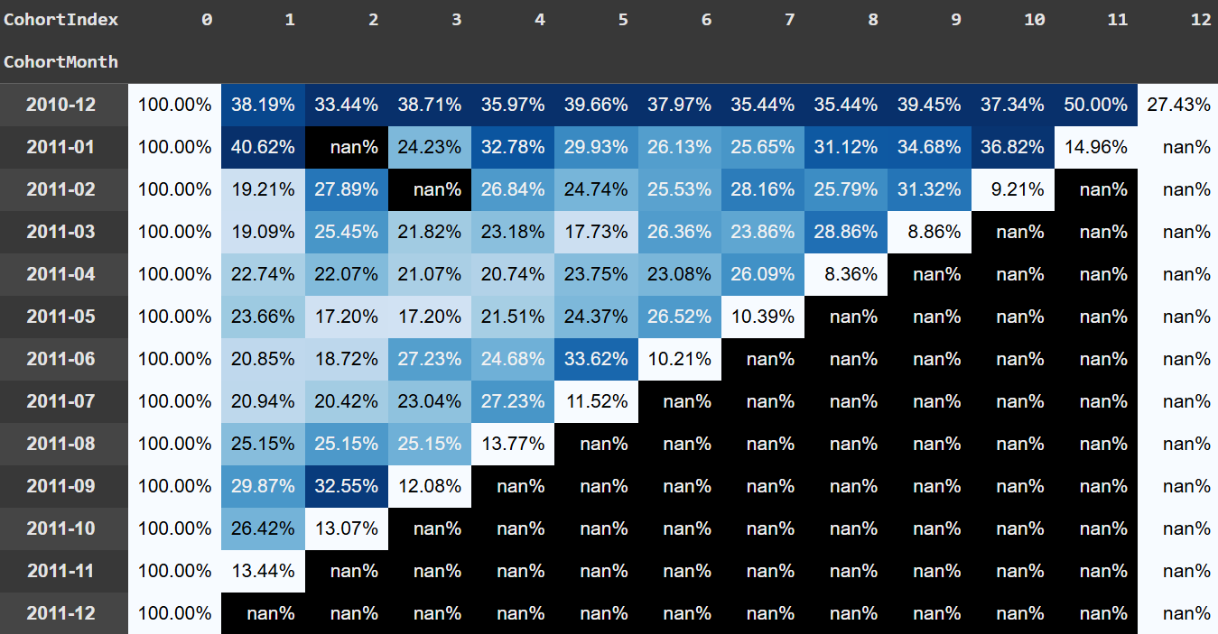
Purchase Intervals
75% repurchase within 60 days; 50% within 30 days.
Outliers: intervals exceeding 150 days, indicating inconsistent behavior.
Cohort Analysis
Early cohorts (Dec 2010, Jan 2011) retain better than newer ones (June 2011).
Long-term retention (Dec 2010): ~33%-39%; spikes in Month 11 (~50%).
Retention dips sharply between Month 0 and Month 1.

Slide 6
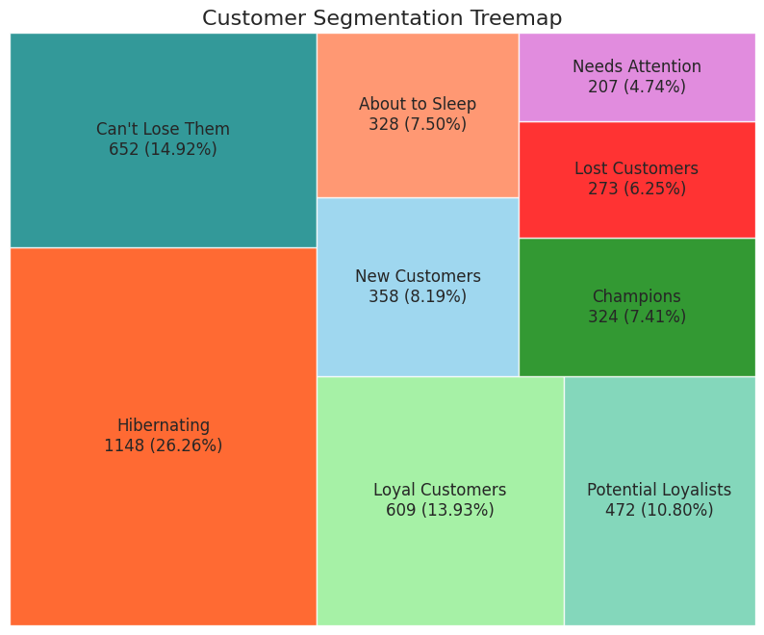
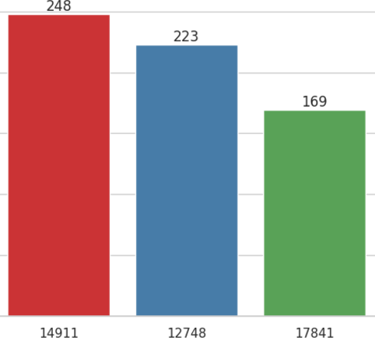
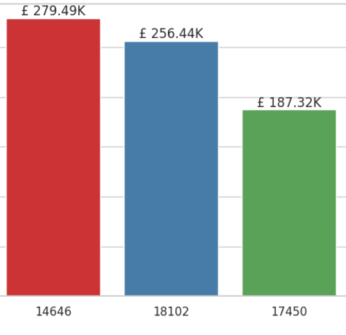
Customer Analysis
Customer Segmentation (RFM Analysis)
Most active: ID 14911
Highest CLV: ID 14646 (£280K)

Slide 7

Recommendations for Business Stakeholders
Leverage UK dominance: Target campaigns to sustain high sales.
Address cancellation trends for key products (e.g., PAPER CRAFT, LITTLE BIRDIE).
Optimize sales timing: Focus promotions midday and during high-sales months.
Retention strategies for at-risk groups (Lost Customers, Needs Attention).
Drive loyalty among high-value customers using personalized offers.

Slide 8
Insights reveal significant trends in country dominance, product performance, and customer behavior.
Prioritize customer segmentation and retention to enhance CLV and sales consistency.
Recommendations provide actionable paths for optimizing marketing and operational strategies.
Conclusion

Slide 9
Thank You

